Slide 1
IBM CAPSTONE PROJECT – The Battle of Neighborhoods: analysis OF London housing markets with Machine learning

Slide 2
Business Problem
London Housing Market is in a “rut”
Brexit
Hidden price falls
Record-low sales
Homebuilder exodus
Tax increase in England and Wales

Slide 3
Project IDEA
How can we help these buyers purchase property that will net them back a positive value investment in spite of all the financial and economic challenges?

Slide 4
solution
Cluster London neighborhoods to recommend venues and the current average price of real estate where homebuyers can make a real estate investment.

Slide 5
dATA
To analyze and recommend locations across different venues of "positive" values, we will use FourSquare API to access data and present it as a dataframe in form of data visualization.
Combine the data on London properties with the relative price paid data from the data source link and data of "positive" values near properties from the FourSquare API interface.

Slide 6
mETHODOLOGY
Collection and Inspection of Data
Exploring and Understanding Data
Data Preparation/Preprocessing
Modeling

Slide 7
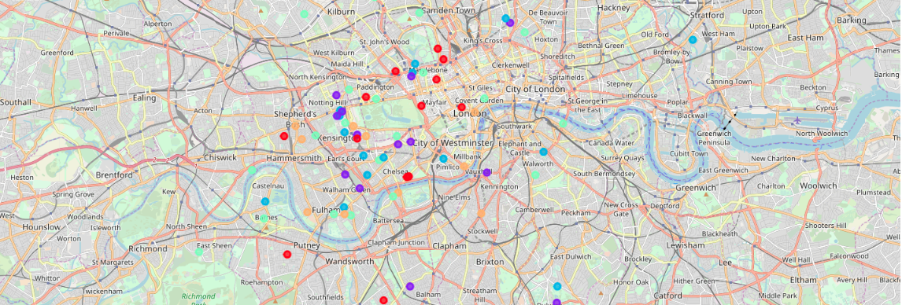
K-Means clustering

Slide 8
Results
Examination of real estates according to neighborhoods/London areas
West London (Notting Hill, Kensington, Chelsea, Marylebone) and North-West London (Hampsted) might be considered highly profitable venues to purchase a real estate;
South-West London (Wandsworth, Balham) and North-West London (Isliington) are arising as next future elite venues with a wide range of amenities and facilities.
Examination of real estates by clusters
Clusters 0, 2 and 4 may target home buyers prone to live in 'green' areas with parks, waterfronts;
Clusters 1 and 3 may target individuals who love pubs, theatres and soccer.

